Slide 1

CT336/CT404 Graphics & Image Processing Sem 1 (Autumn) 2024-25, Dr. Nazre Batool 4th year B.Sc. (CS&I.T.). 2nd year M.Sc. (Software Development & Design) 1st year M.Sc. (Biomedical Engineering) Visiting students

Slide 2
Lecture 6: Morphological Image Processing
Last Lecture:
Image Filtering in Spatial Domain (part 2 of 2)
Image Filtering in Frequency Domain
What is a frequency domain?
2D Fourier Transform
Low-pass and high-pass filters
Today:
Binary Image Processing using Morphological Techniques
What is morphology?
A morphological image processing pipeline
Basic morphological operations
Extraction of binary regions (connected components)
Distance Transform & Skeletonization
Properties of Binary Regions
Acknowledgement: These lecture slides have been prepared using digital materials available with your Text book: ‘Image Processing and Analysis by Stan Birchfield, 1st Edition, Cengage Learning’

Slide 3
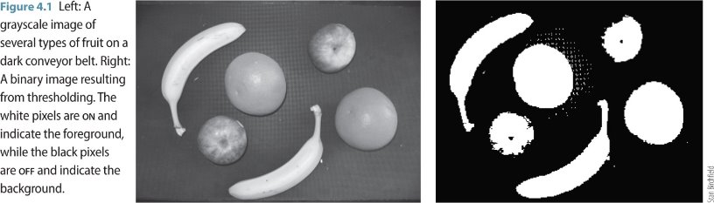
Morphological Image Processing
The term 'morphology' refers to shape
Morphological image processing assumes that an image consists of structures that may be handled by mathematical set theory
Normally applied to binary (B&W) images – e.g. after applying thresholding
A 'set' is a group of pixels
Different set operations can be performed on this ‘set’ of pixels
*

Slide 4
Morphological Image Processing
Applications: Image Analysis at a very small scale (small regions of pixels)
Medical Image Processing
Scientific Image Processing
Industrial Inspection
A general morphological image processing pipeline
Binary Image
Filter components based on property values
Thresholding
Noise Removal/Pre-Processing
Opening, Closing
Connected Components
Calculation
Or Skeletonization
Or Distance Transform
Calculate Region Properties of components or skeleton or Distance Transform
Input Image
Output Image

Slide 5
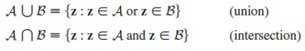
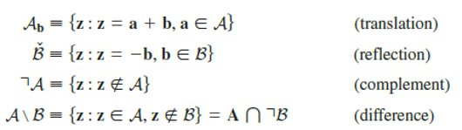

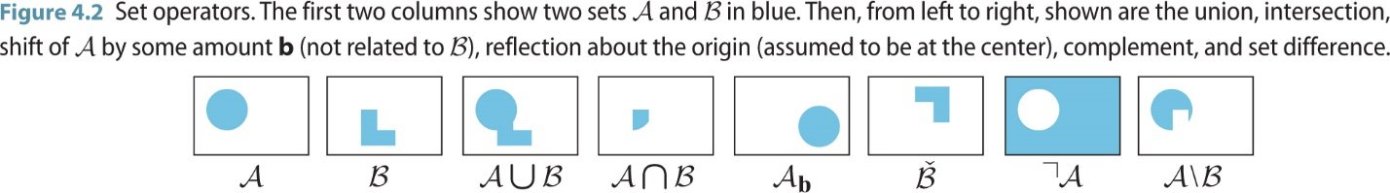
Morphological Image Processing
Basic Set Operations:

Slide 6
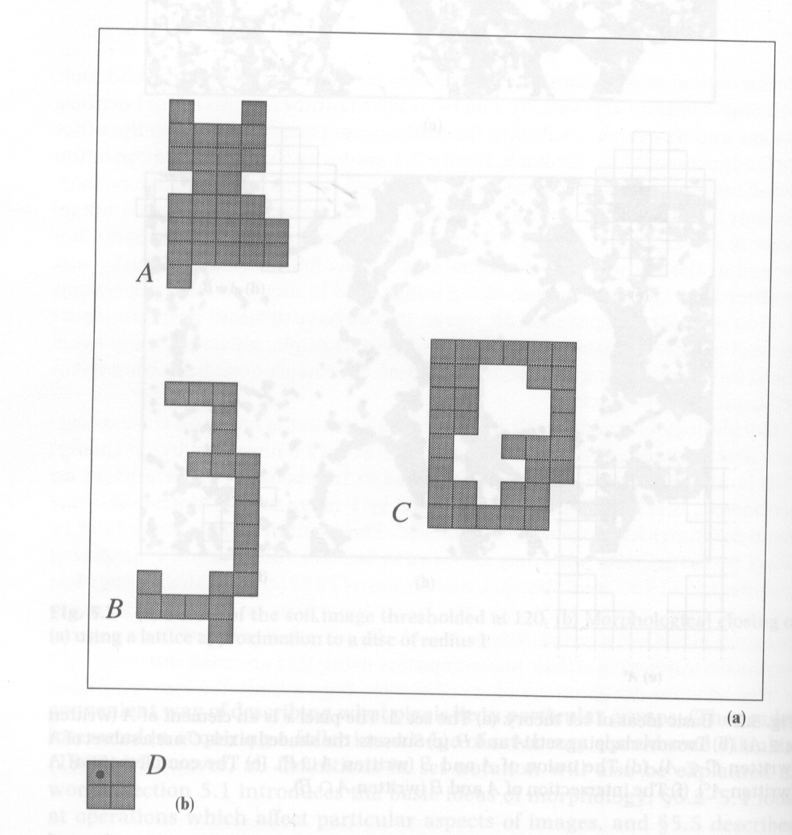
Morphological Image Processing
Structuring Element (SE) :
We can describe morphological differences is in terms of intersections with 'test' sets (Structuring Elements)
SE’s are of much smaller size than the original image
The three black objects A,B,C are very similar in size (i.e. number of pixels) but different in morphology/shape
e.g. several possible translations of D will fit into A, but none will fit into B
Morphological operations transform an image => changing a pixel from black to white (or vice versa) if a defined structuring element 'fits' at that point
The shape+size of the structuring element directly affect the information about the image obtained by the operation
Test sets, or 'structuring elements‘ such as D allow analysis of shape
Reference
pixel

Slide 7
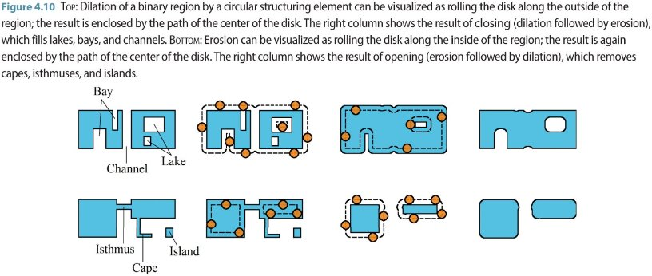
Basic Morphological Operations
These operations are performed by set operations between a given image and an SE
Erosion, Dilation, Opening, Closing

Slide 8
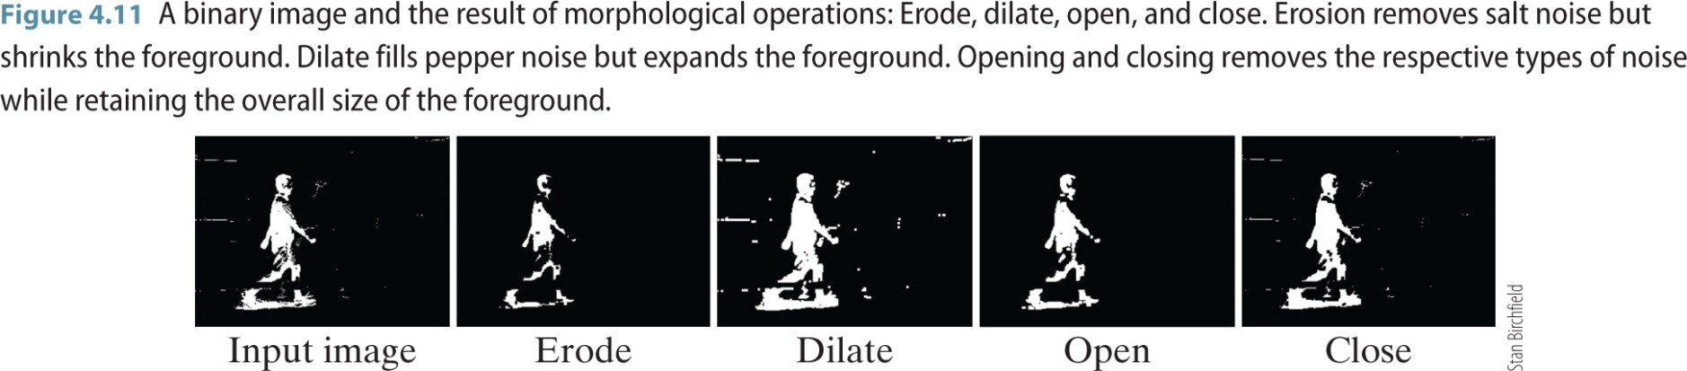
Basic Morphological Operations

Slide 9


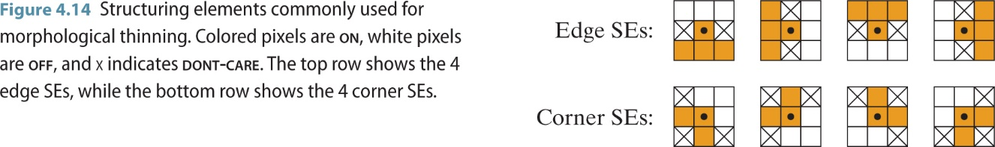
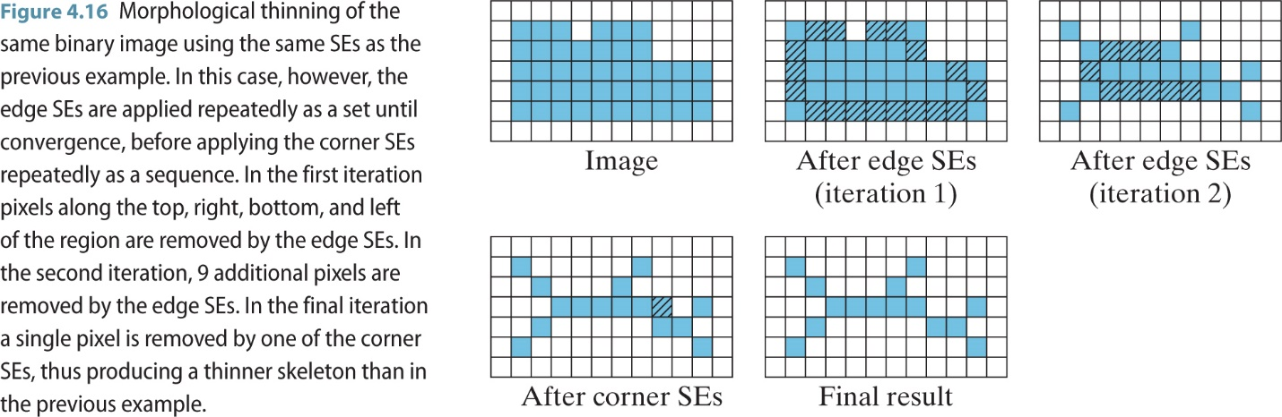
Basic Morphological Operations
Thinning: Clever erosion (removing pixels) by crafted Ternary SE’s (on, off, don’t care X)

Slide 10
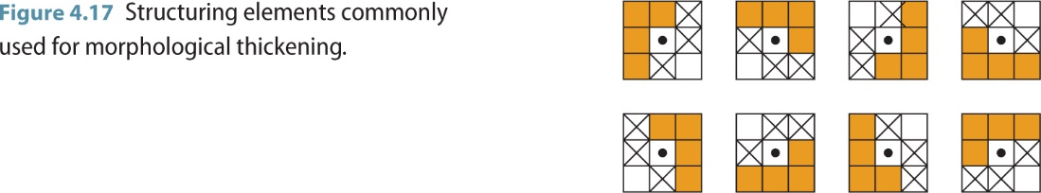
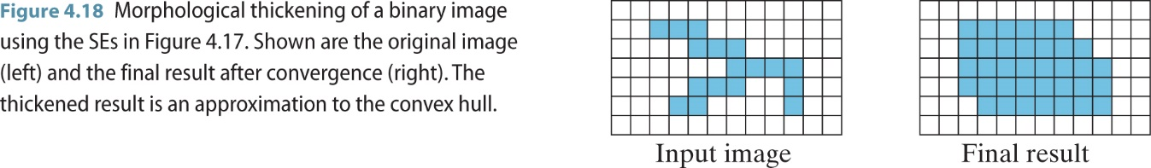
Basic Morphological Operations
Thickening: Opposite of Thinning (add pixels to foreground)

Slide 11
Morphological Image Processing
A general morphological image processing pipeline
Binary Image
Filter components based on property values
Thresholding
Noise Removal/Pre-Processing
Opening, Closing
Connected Components
Calculation
Or Skeletonization
Or Distance Transform
Calculate Region Properties of components or skeleton or Distance Transform
Input Image
Output Image

Slide 12
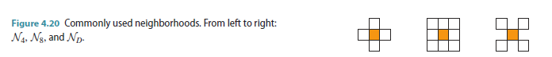
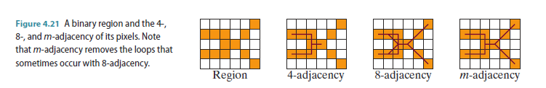
Connected Components
Neighbors and Connectivity:
A pixel q = (qx, qy) is a neighbor of pixel p = (px, py) if q is in the neighborhood of p, denoted 𝑞∈𝛮(𝑝) where N is the neighborhood function.
Two pixels are said to be adjacent if they have the same value and if they are neighbors of each other.
Pixels are said to be connected (or contiguous) if there exists a path between them

Slide 13
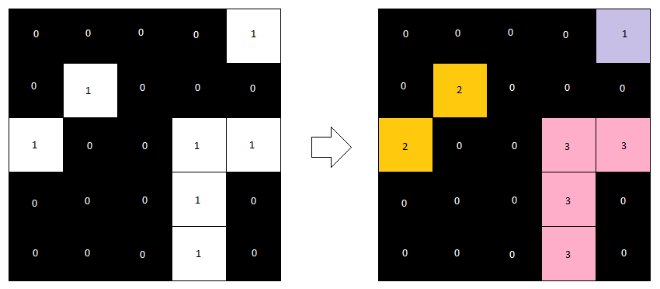
Connected Components
Connected component: defined as a maximal set of pixels that are all connected with one another.
Connected component labeling: the process of assigning a unique identifier to every pixel in the image indicating to which connected component it belongs.
How are connected components calculated?
Binary Image Labelled connected components
Image source

Slide 14
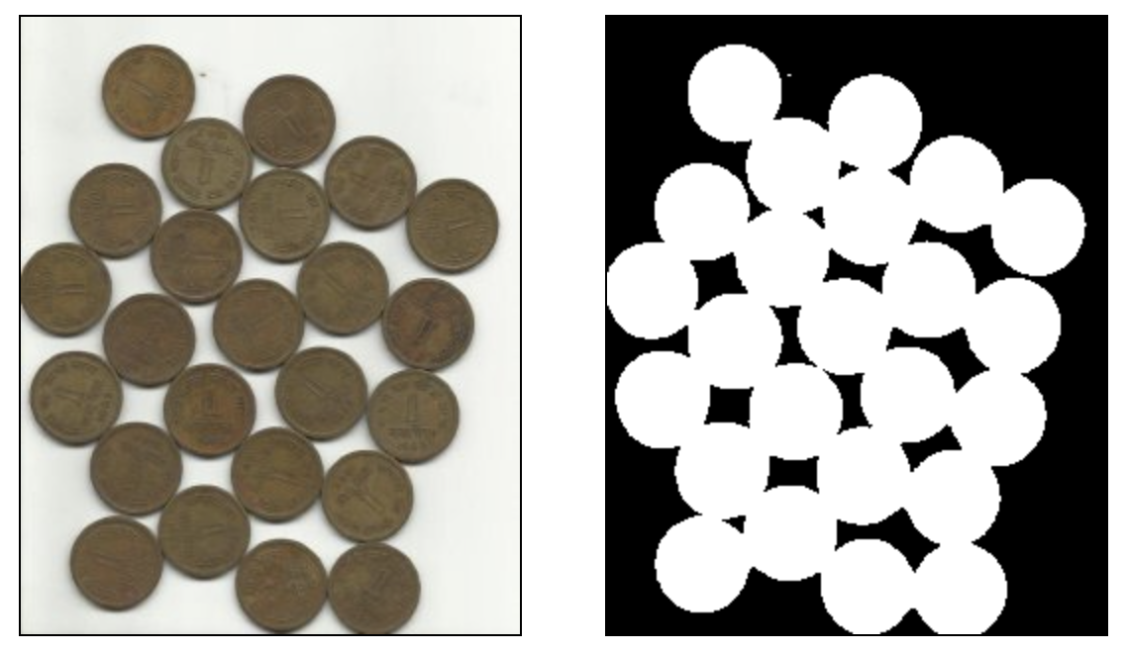
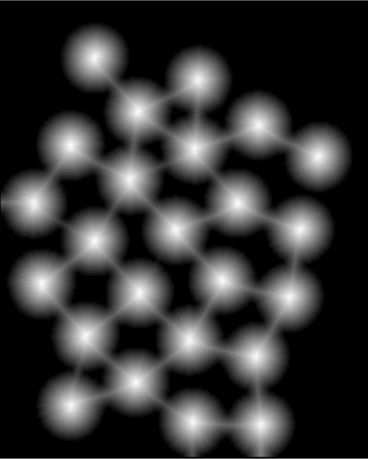
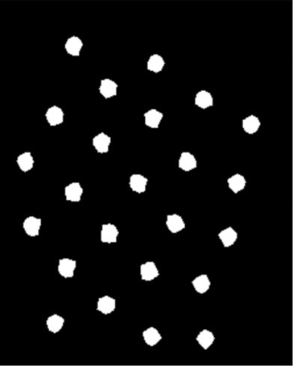
Distance Transform
Replaces pixels of one value (black or white) in a binary image with their distance to the nearest pixel of opposite value (white or black)
Useful for template matching
or ‘granulometry’ (=studying the size distribution/properties of objects) – this allows the study of groups of objects:
How many? What size?
How are they distributed spatially?
The assumption is that a local maximum is the centre of a distinct object: use ‘non-maximal suppression’ to remove all other pixels
After threshold
Distance transform
of the thresholded image
Result after threshold applied to distance transform

Slide 15
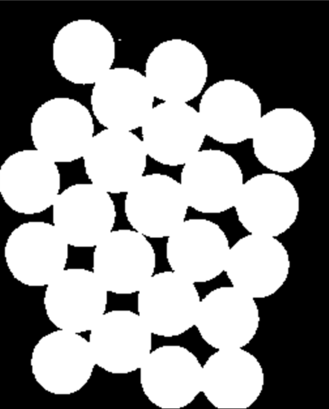

Distance Transform
What is the difference?

Slide 16
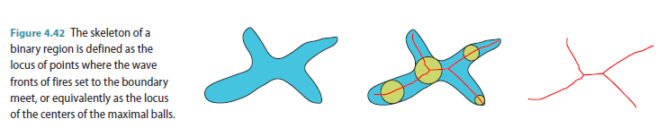
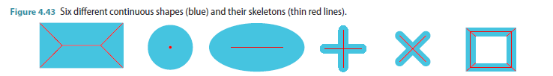
Skeletonization
A common approach to skeletonization is to repeatedly thin the image until the result converges.
Different skeletonization algorithms are available.

Slide 17
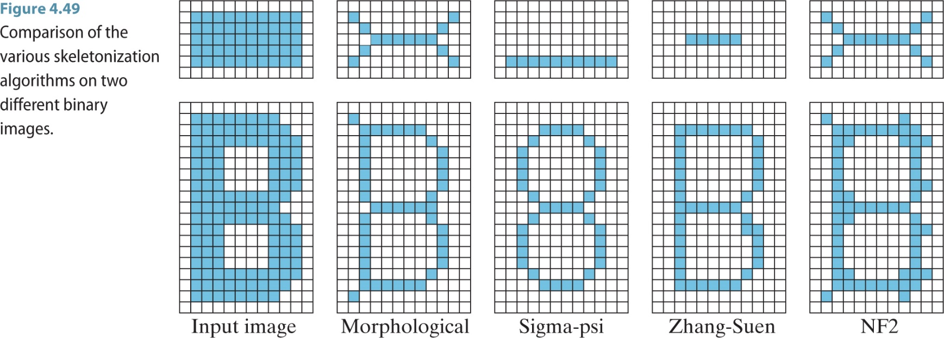
Skeletonization
Different skeletonization algorithms are available.

Slide 18
Morphological Image Processing
A general morphological image processing pipeline
Binary Image
Filter components based on property values
Thresholding
Noise Removal/Pre-Processing
Opening, Closing
Connected Components
Calculation
Or Skeletonization
Or Distance Transform
Calculate Region Properties of components or skeleton or Distance Transform
Input Image
Output Image

Slide 19
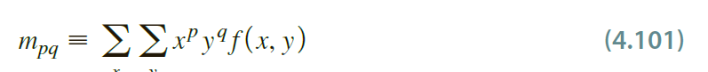
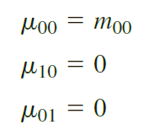
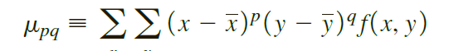
Region Properties
Regular Moments
Central Moments
Covariance Matrix
Area
Perimeter
Orientation (From Covariance Matrix)
Compactness
Eccentricity
Convex Hull
Euler Number

Slide 20
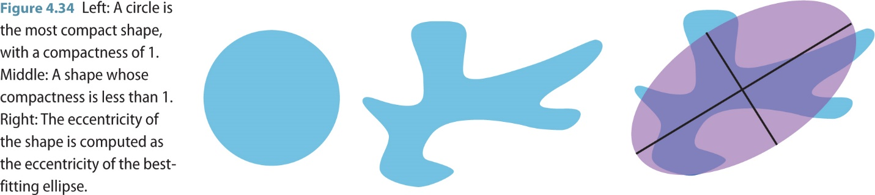
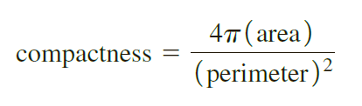
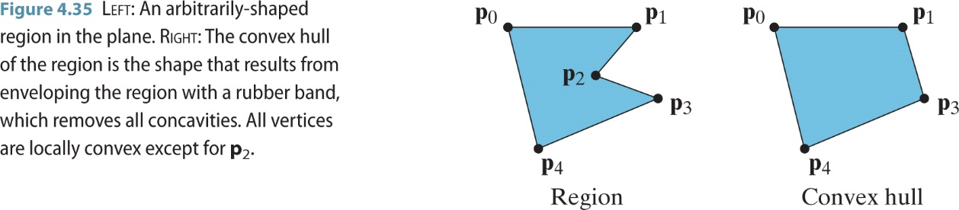
Region Properties
Compactness
Convex Hull: Find convex hull of a binary region and calculate its properties instead.

Slide 21
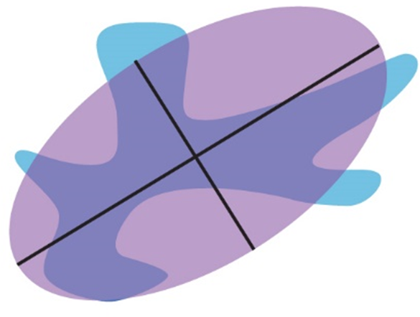
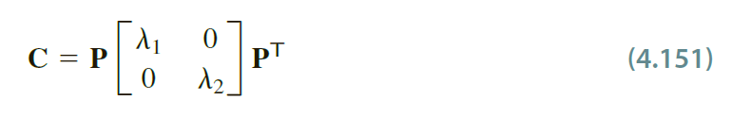
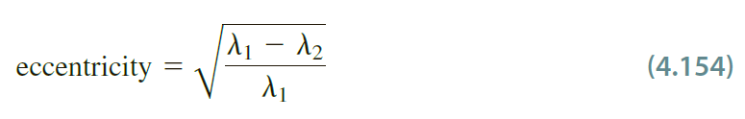
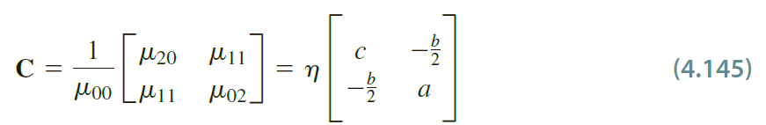
Region Properties
Eccentricity
Measures the elongatedness of a binary region i.e. how far it is from being rotationally symmetric around its centroid.
How to calculate it?
Find the best/tightest fitting ellipse around the region
Then align this ellipse with the axes
Find the Covariance Matrix of this ellipse
The eccentricity will be a ratio of the eigen values of this matrix
NOT surprisingly, this covariance matrix is obtained by using the moments of the binary region encapsulated by the ellipse

Slide 22
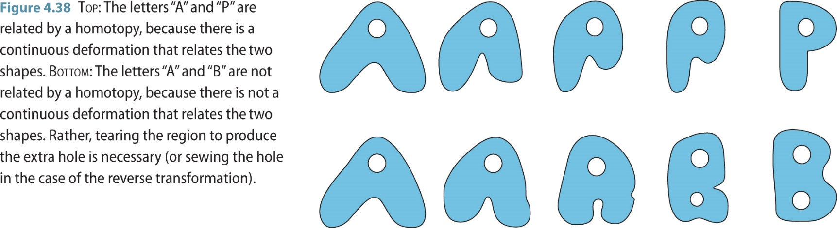
Region Properties – Euler Number
Mathematical Topology:
Study of properties of objects that are preserved under continuous deformations of the objects e.g. bending, stretching and compressing but NOT tearing or sewing.
Homotopy/rubber sheet deformations:
defined to be the deformation which does NOT change the topology of the object

Slide 23
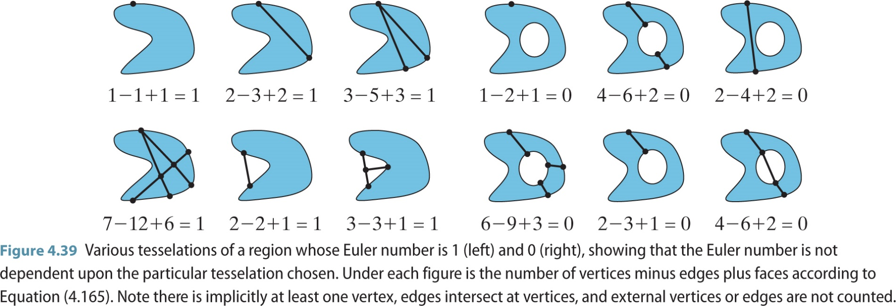
Region Properties – Euler Number
Euler Number/Characteristic: A topological invariant characteristic

Slide 24
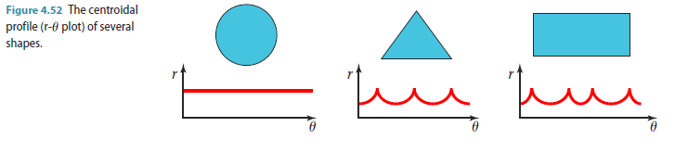
Region Boundary Representations
Classically used in ‘shape’ analysis or recognition
For distinguishing the shape of the boundary, generally we want to transform the sequence into a representation that is invariant to translation, rotation, and/or scale changes, as well as to the starting pixel.
Signature: The most basic type of signature is known as the centroidal profile, or r-𝜃 curve.
This approach captures the distance r from the center of the region as a function of the angle 𝜃.

Slide 25
Next Time
Edges & Features
Image Segmentation (Part 1 of 2)

Slide 26
Thank you

